Slide 1
Process and Findings

Slide 2
The Event
A blend of communications, performance management, and pavement management experts from diverse states and FHWA

Slide 3
NCHRP 20-24 Task 124 Performance Management Reporting Peer Exchange
Meadow Bailey, Alaska Department of Transportation & Public Utilities
Jessie Jones, Arkansas Department of Transportation
William Johnson, Colorado Department of Transportation
Michael Cohen, Connecticut Department of Transportation
Edward Carpenter, District Department of Transportation
Ting Ma, District Department of Transportation
Susanna Reck, Federal Highway Administration
Melanie Rigney, Federal Highway Administration
LaToya Johnson, Federal Highway Administration
Chapman Munn, Idaho Department of Transportation
William Morgan, Illinois Department of Transportation
John Selmer, Iowa Department of Transportation
Valerie Burnette Edgar, Maryland Department of Transportation
Craig Newell, Michigan Department of Transportation
Deanna Belden, Minnesota Department of Transportation
Tamara Haas, New Mexico Department of Transportation
Larissa Newton, Pennsylvania Department of Transportation
Chad Rawls, South Carolina Department of Transportation
BJ Doughty, Tennessee Department of Transportation
Monte Aldridge, Utah Department of Transportation
Jay Styles, Virginia Department of Transportation

Slide 4
The Challenge

Slide 5
The Challenge
Develop a communication strategy to help explain the difference between your state pavement performance measure and the Federal pavement performance measure

Slide 6
System Level Perspectives Matter
DOT
FHWA
DOT
FHWA
DOT
FHWA
DOT
FHWA
If your metric is % good, the FHWA metric will make your performance appear worse
2013
2014
2015
2016

Slide 7
System Level Perspectives Matter
DOT
FHWA
DOT
FHWA
DOT
FHWA
DOT
FHWA
If your metric is % good or fair, the FHWA metric will make your performance appear to improve
2013
2014
2015
2016

Slide 8
System Level Perspectives Matter
DOT
FHWA
DOT
FHWA
DOT
FHWA
DOT
FHWA
If your metric is % poor, the FHWA metric will make your performance appear to improve significantly
2013
2014
2015
2016

Slide 9
Common Messaging Themes

Slide 10
Perspectives: Power in Data
State DOTs
Federal DOT
Measure roadways and bridges to assess progress
Have been collecting data for years/decades
Use data to help make investment decisions
Developed common measures to help understand the health of the national transportation system
Developed new measures that are different, in some ways, from how states have assessed their systems in the past

Slide 11
Perspectives: State Flexibility
State DOTs
Federal DOT
Have different weather, geographical settings, traffic patterns and maintenance plans that affect pavement conditions in different ways
Make their own funding decisions
Seeking a complete picture of the condition of the national system, and therefore requires pavement data collected in the same way for each state

Slide 12
Shared Goals
Transportation departments at the federal, state and local levels all share the same goals:
Work every day to deliver an efficient, effective, and safe transportation system for the American people
Use tax dollars in a wise and effective way to deliver a better system
Better data will lead to better decisions, investments and improve system performance

Slide 13
Key Points
Keep it Simple | Message points should be deceptively simple (limit conflict)
Teamwork | National and state agencies working together is what the public expects
Common-sense | The new measure should be framed as a common-sense approach
Focus on Tax-payers | Making these talking points about tax-payers rather than the nuance of policy, increase the likelihood they will be well received

Slide 14
Reminders
Deceptively Simple | Simplicity helps limit conflict and decrease the chance of negative public perception
The public are not pavement condition or data collection experts | General outlines of what is collected and why they are different is enough
Detailed State Specific Data | If requested, additional state specific details can be provided, but those details shouldn’t be the starting point

Slide 15
State DOT Specific Examples
Augment the earlier message points with state specific information and graphics

Slide 16
California Asset and System

Slide 17
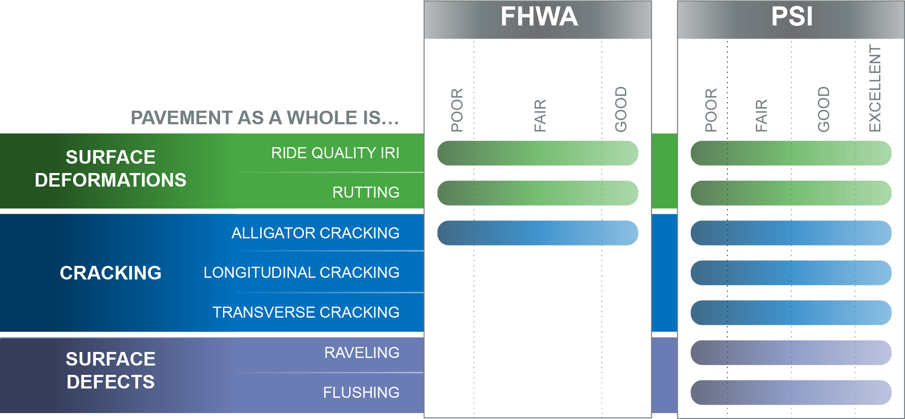
Massachusetts Thresholds and Distresses

Slide 18
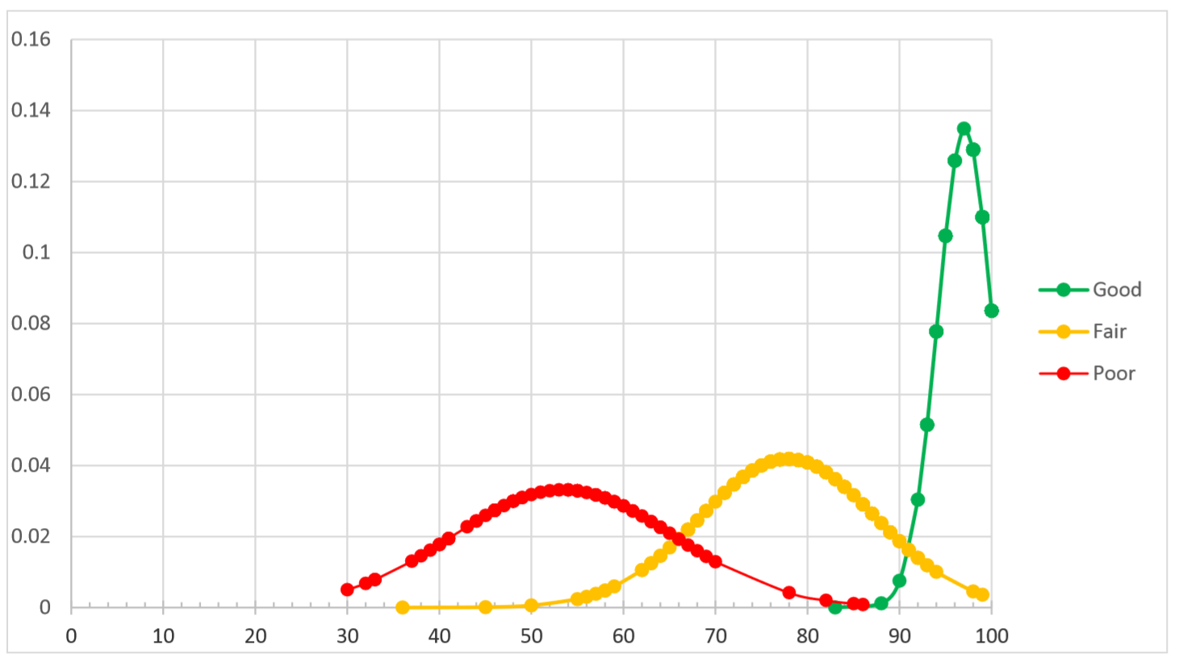
Rhode Island Sampling Comparison
FHWA
%ile
PHSI

Slide 19
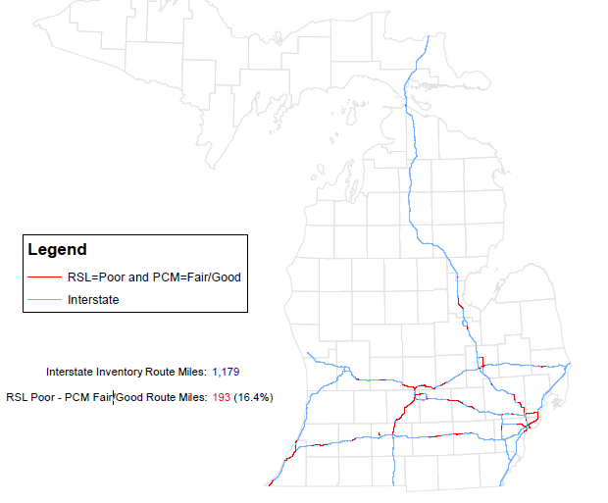
Michigan Geographic Comparison
RSL is the Michigan measure
PCM is the Federal measure
The segments in red are those where RSL is poor and PCM is Fair/Good

Slide 20
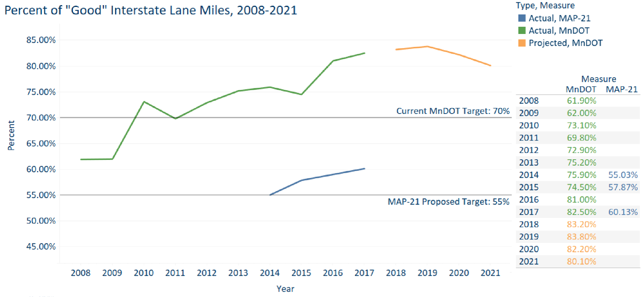
Minnesota Trend Comparison

Slide 21
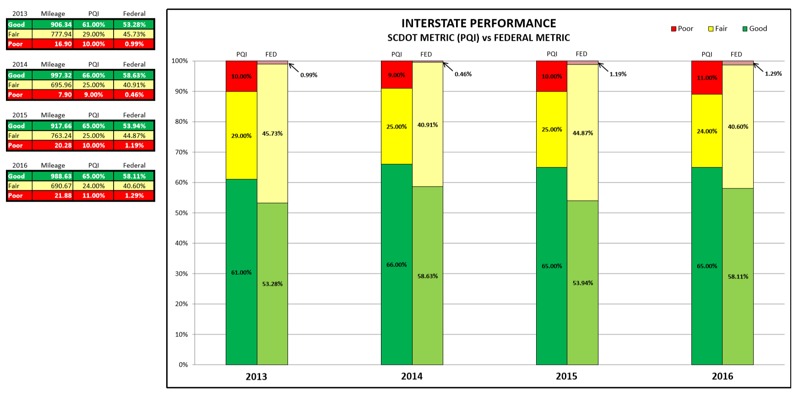
South Carolina Stacked Bar Comparison

Slide 22
Process and Findings

Slide 23
Additional State DOT Specific Data Examples
Can be incorporated to illustrate the differences

Slide 24
Washington Frequency and Coverage

Slide 25
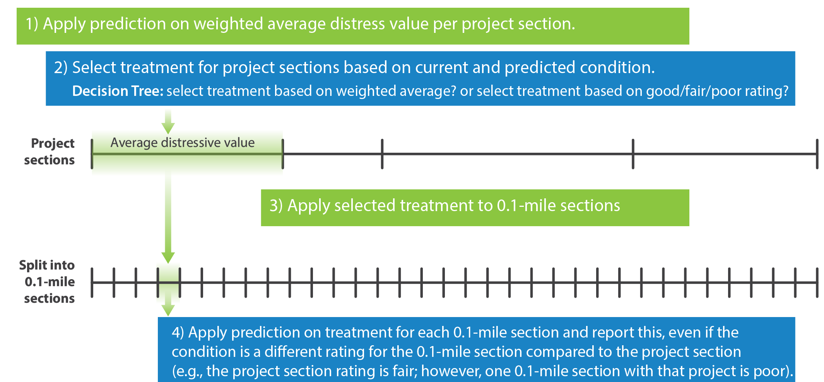
Arizona Segments
Notes:
Process of prediction, selection, and reporting:
Data is collected in 0.1-mile sections.
0.1-mile sections are combined into longer project sections.
The overall condition of the project section is used to determine the treatment for that entire project section. (i.e. Prediction models are applied to the weighted average distress value per project section. Then, treatment is selected for each project section based on current and predicted condition.)
The treatment that was determined at project-level is applied for each 0.1-mile section within each project. Prediction models are then applied to each 0.1- mile section and results are reported.
Note: The condition may be a different rating for the 0.1-mile section compared to the project section (e.g. the project section rating is fair; however, one 0.1-mile section within that project is poor).

Slide 26
Kansas Crack Severity
Notes:
The pavement condition requirements in the Final Rule are consistent with the NPRM requirements, with one major exception—the percent cracking in AC pavements. In the NPRM, AC percent cracking was to be calculated as the percentage of the total area exhibiting longitudinal cracking (wheel path and non-wheel path), edge cracking, transverse cracking, fatigue cracking, and block cracking. In the Final Rule, the AC percent cracking was to be calculated as the percentage of the total area based on the area of the wheel paths exhibiting longitudinal cracking and fatigue cracking. As noted later in this chapter and at the request of FHWA, the percent cracking in AC pavements was calculated using both formulations in this project. Source: https://www.fhwa.dot.gov/publications/research/infrastructure/pavements/ltpp/17089/17089.pdf Validation of Pavement Performance Measures Using LTPP data

Slide 27
California International Roughness Index (IRI) on 45 MPH Roads

